Slide 1
NE 763: Advanced Reactor Materials
Fall 2026
Dr. Benjamin Beeler

Slide 2
High Temperature Gas reactors and TRISO Particles

Slide 3
High Temperature Gas Reactor
The HTGR has a long history going back to the earliest days of nuclear energy development
Commercial gas-cooled nuclear power for electricity production started in 1956 with the operation of the first 50 MWe unit in the UK
The design, which came to be known as Magnox, featured carbon-dioxide as the pressurized coolant, magnesium-aluminum alloy for the cladding, and graphite as moderator
To raise thermal efficiency, later designs switched to stainless steel cladding, enriched uranium oxide fuel, higher CO2 pressures, and higher operating temperatures, in what came to be known as the Advanced Gas Reactor (AGR)

Slide 4
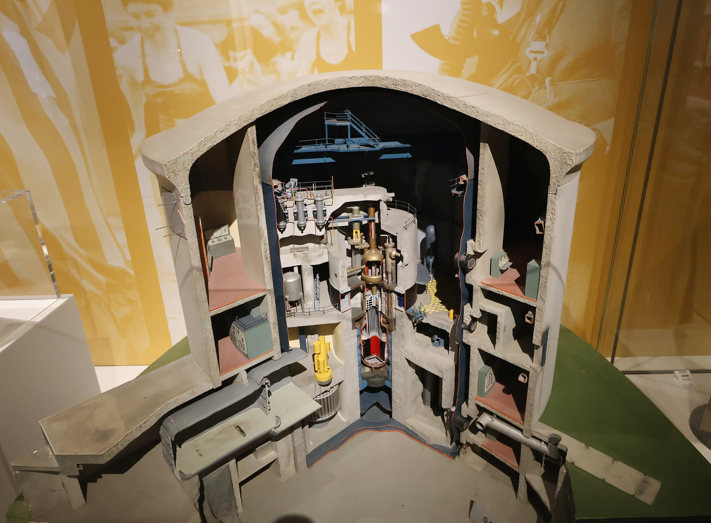
HTGRs
The use of helium (He) as a coolant was advocated as early as 1944 in a 5 MWt experimental reactor project, also featuring an indirect gas turbine cycle
Later, the prototype DRAGON reactor was put into operation in the UK in 1965 and featured a steel pressure vessel, coated fuel particles of highly-enriched uranium-thorium carbide fuel, with a helium outlet temperature of 750ºC
Cutaway model of Dragon reactor

Slide 5
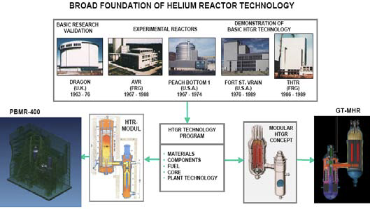
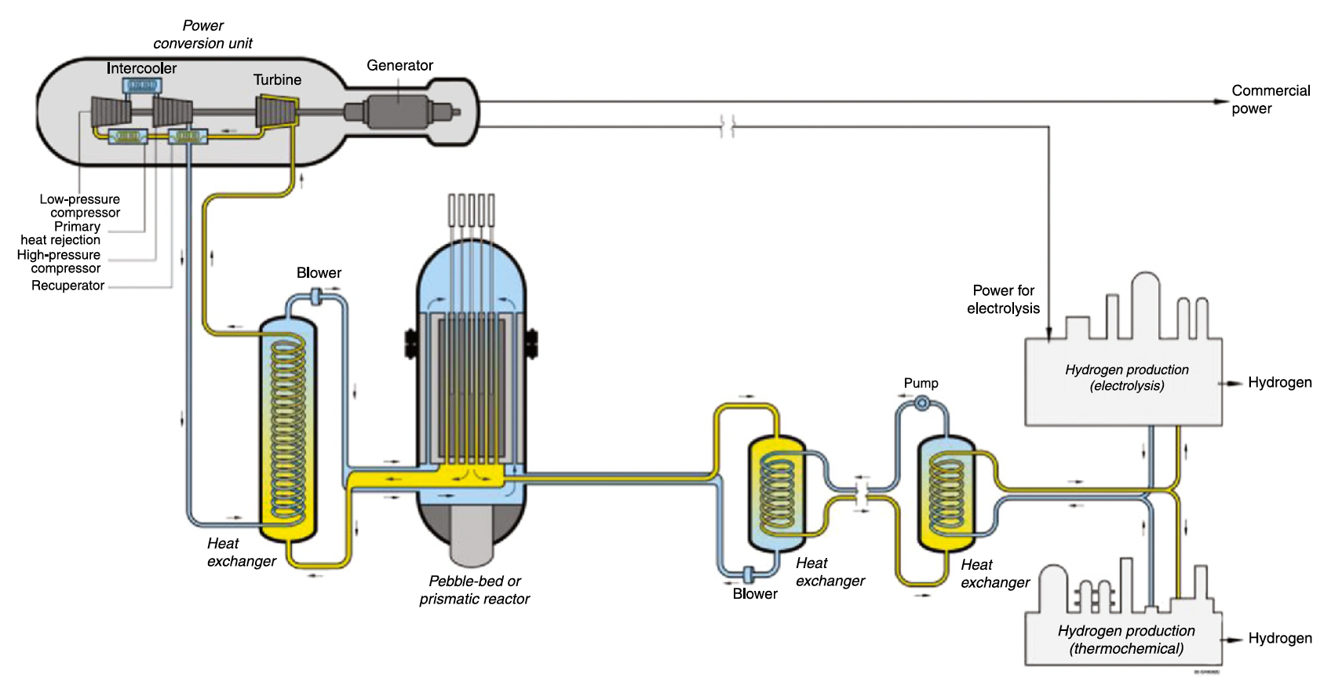
HTGRs
The substitution of He instead of air or CO2 provided excellent neutronic and thermal characteristics together with a graphite moderator
There are two mainstream HTGR design concepts; the prismatic core design and the pebble bed core design, both of which possess common advantages of the HTGR design such as inherent safety and high efficiency

Slide 6
Two types of HTGRs

Slide 7
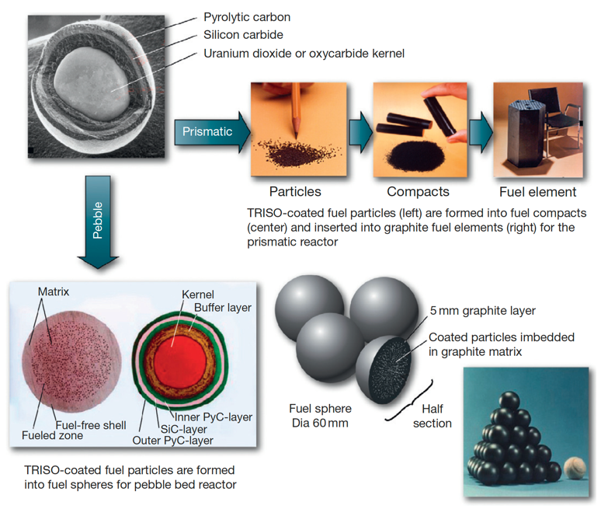

Slide 8
HTGRs
The main features of HTGRs are enhanced safety, high thermal efficiency, economical competitiveness, and proliferation resistance and these make this technology a potential candidate for the nuclear power plant deployment
One of the driving forces behind the HTGR philosophy is its utilization in the production of process heat: the high outlet gas temperatures may be utilized as a thermal heat source in endothermic chemical processes
Net thermal efficiencies greater than 45% are within the reach in some of the designs of HTGRs
The enhanced safety of the HTGR fuel is based on its coated fuel particle design consisting of uranium oxide/carbide particles coated with layers of pyrolytic carbon and silicon carbide
Coated particles are so designed that they can withstand high internal gas pressure without releasing any fission products to the environment

Slide 9
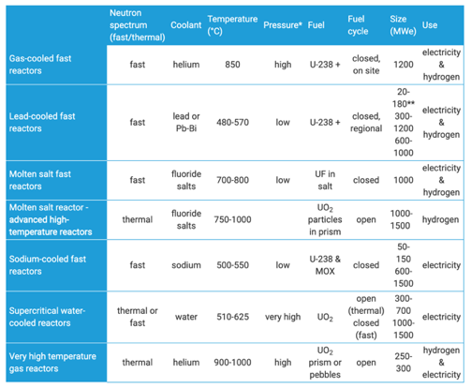
HTGRs
Difference from LWRs
helium cooled
much higher temperatures
thermal/fast options
extensive utilization of graphite
flexibility of fuel
high burnup

Slide 10
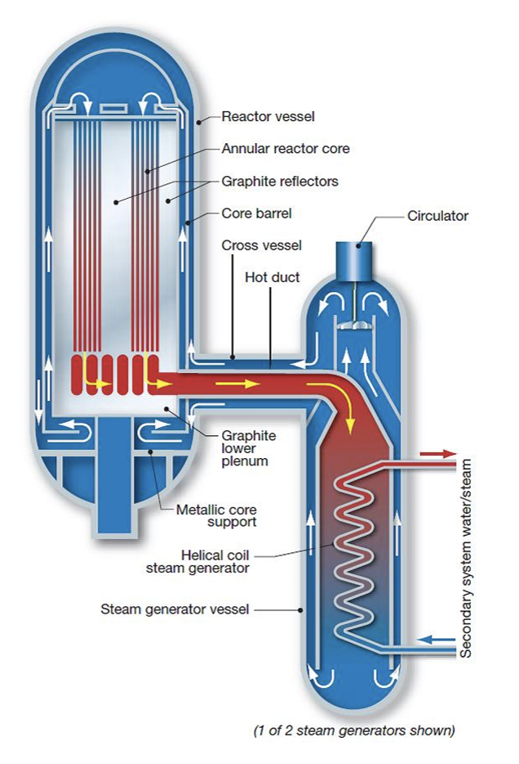
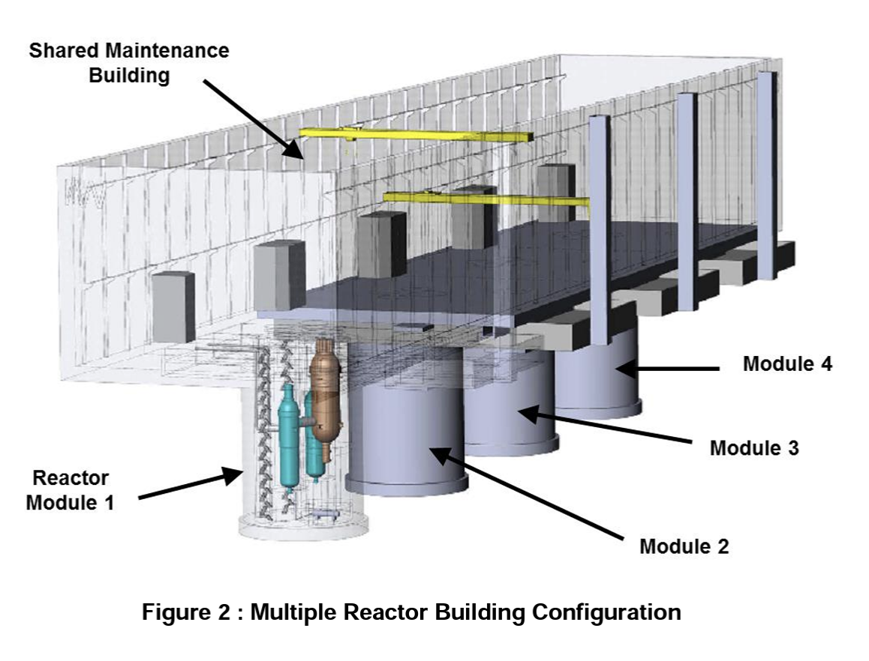
Framatome SC-HTGR
Steam Cycle High Temperature Gas-Cooled Reactor (SCHTGR)
Modular, graphite-moderated, helium-cooled, high temperature reactor with a nominal thermal power of 625 MWth
HALEU UCO fuel kernel in TRISO particles
Graphite hexagonal prism blocks
Core inlet: 350C; Core outlet: 750C

Slide 11
Brief Summary
History of HTGRs
Magnox and Dragon in the UK
Moved into He-cooled designs
Two main types:
Pebble bed with spherical compacts
Prismatic with cylindrical compacts
Main features:
inherent/increased safety, high temperatures, high fuel burnup

Slide 12
Questions?

